Slide 1
Brick Breaker 3D
Osman Kaan Demiröz

Slide 2
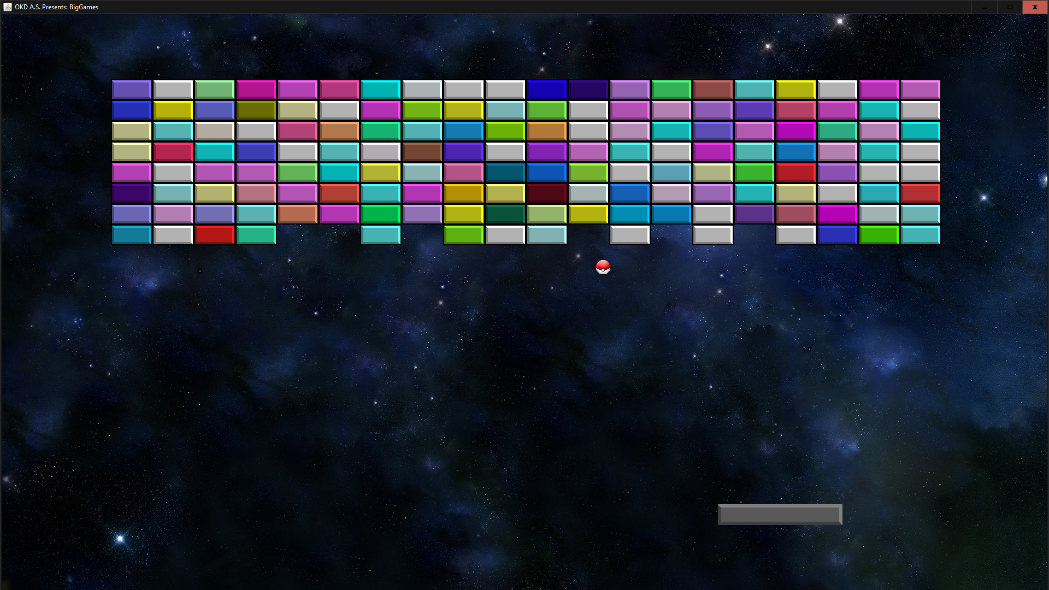
Brick Breaker

Slide 3
3D
Implementation of the game in a 3D Scene
Addition of the DEPTH element

Slide 4
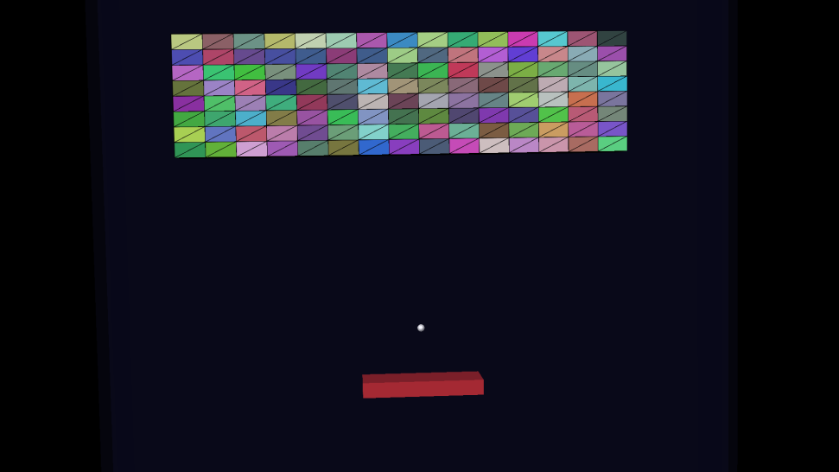
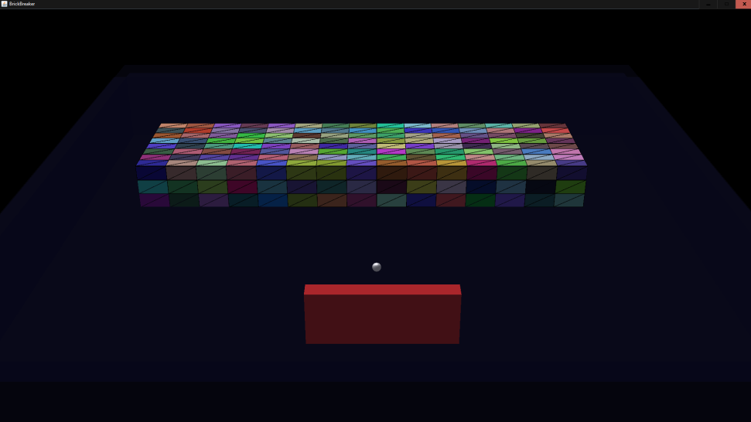
Depth

Slide 5
JAVA3D
Object Oriented Design
Classes
Hierarchy
Scene Graph Implementation
Branch Groups
Transform Groups
Timer functions are used for animation

Slide 6
User Interaction
Mouse Movement/Clicks
Mouse controls the bottom tray
Click begins the game
Key presses control the flow
I / i for initializing rotation
P / p for pausing the game
Q / q for quitting the game

Slide 7
Appearance
Lights are added as in OpenGL
Directional and Ambient (Point) lights
“Appearance” classes are used for color
Material is also defined the same way
Ambient, Diffuse and Specular components

Slide 8
Collision Detection
One of the main key points in the game
Created a custom class and a custom interface to handle collisions
Ball changes direction according to the direction of the collision.
Blocks are destroyed on collision

Slide 9
Thank you for listening!

